Slide 1
Machine learning
By: Ishan

Slide 2
Difference between AI, ML & Data Science
Artificial Intelligence - In the field of computer science, artificial intelligence (AI), sometimes called machine intelligence, is intelligence demonstrated by machines, in contrast to the natural intelligence displayed by humans and other animals.
Machine Learning - is the scientific study of algorithms and statistical models that computer systems use to effectively perform a specific task without using explicit instructions, relying on models and inference instead. It is seen as a subset of artificial intelligence.
Data Science - Data science is an interdisciplinary field that uses scientific methods, processes, algorithms and systems to extract knowledge and insights from data in various forms, both structured and unstructured, similar to data mining.

Slide 3
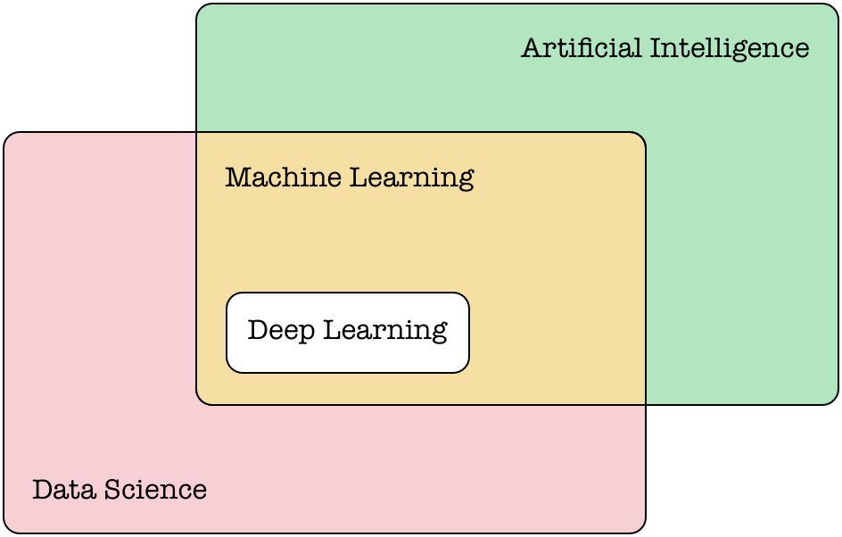
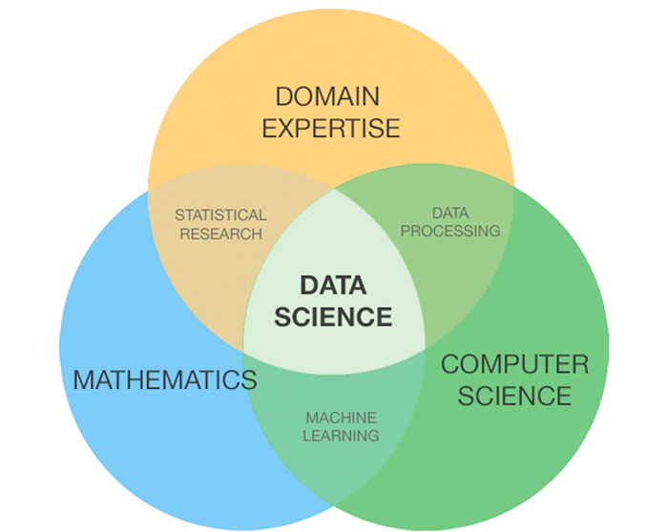
Difference between AI, ML & Data Science
Notes:
AI is just a concept or an idea
ML is a technique and one of the ways to do AI
Data Science is a whole comprehensive process of which ML forms the algorithm part.
It encapsulates wide range of processes starting from data procurement, data cleaning, statistical techniques etc.

Slide 4
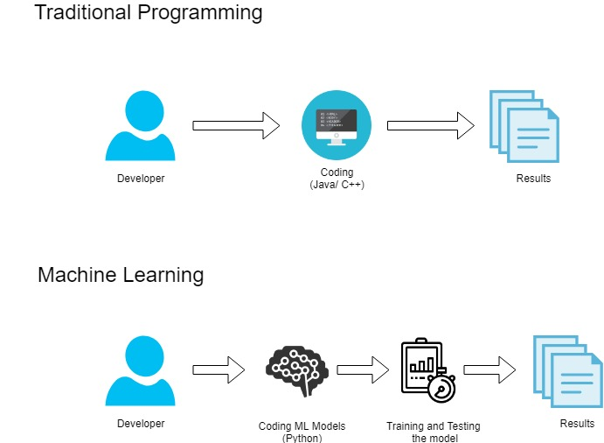
Traditional programming vs ML

Slide 5
Machine learning
A machine learning algorithm is an algorithm learning to accomplish a task by observing data.
Used on complex tasks where it’s hard to develop algorithms with handcrafted-rules
Exploits patterns in observed data and extract rules automatically

Slide 6

Fields of application
Computer vision
Speech recognition
Financial analysis
Search engines
Ads-targeting
Content suggestion
Self-driving cars
Assistants
etc...

Slide 7
Computer Vision

Slide 8
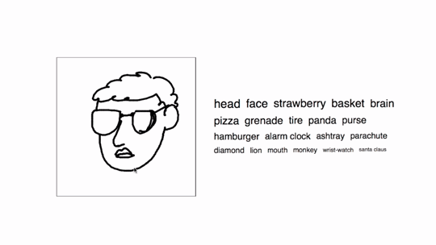

Slide 9
Self Driving Car

Slide 10
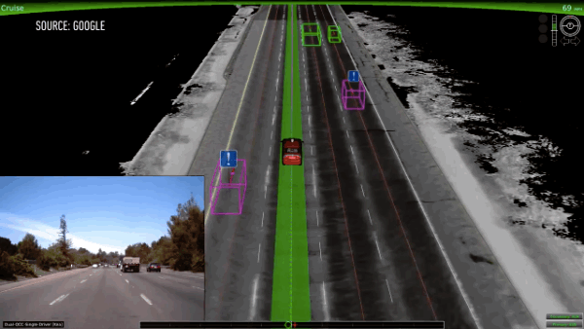

Slide 11
Reinforcement Learning

Slide 12
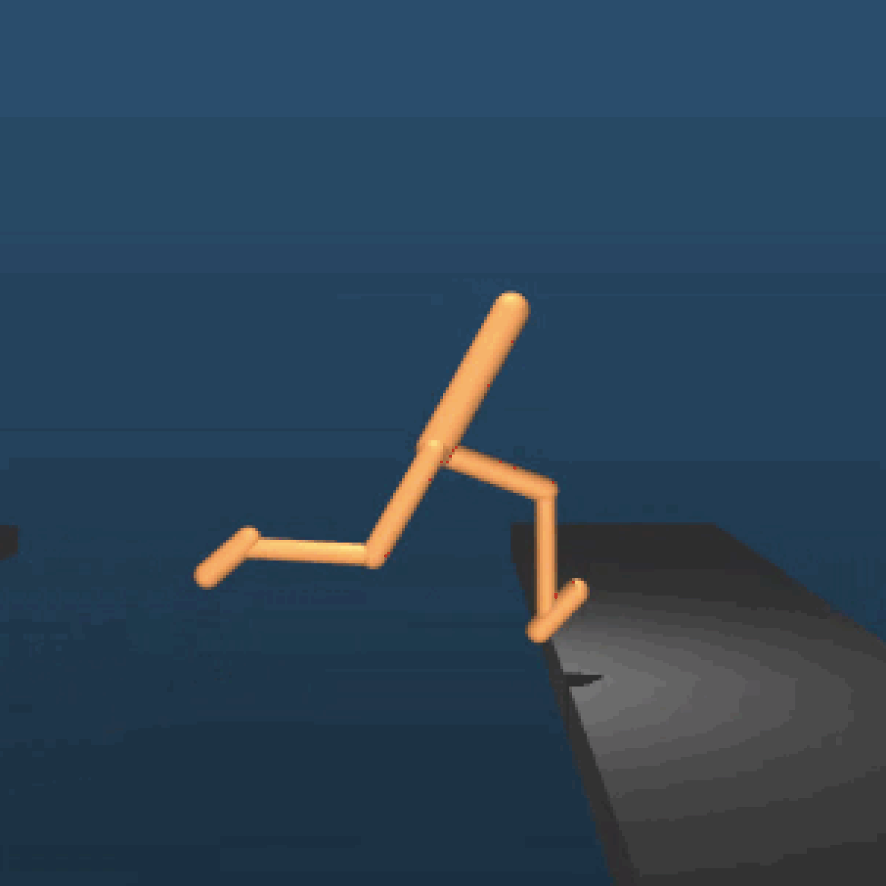

Slide 13
Deep Fakes

Slide 14


Slide 15
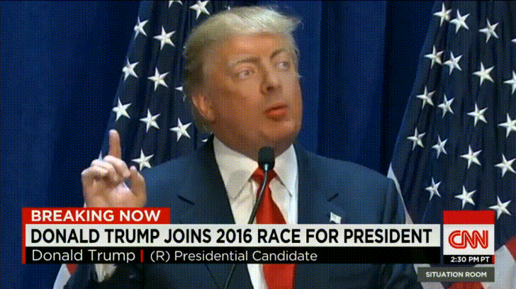

Slide 16
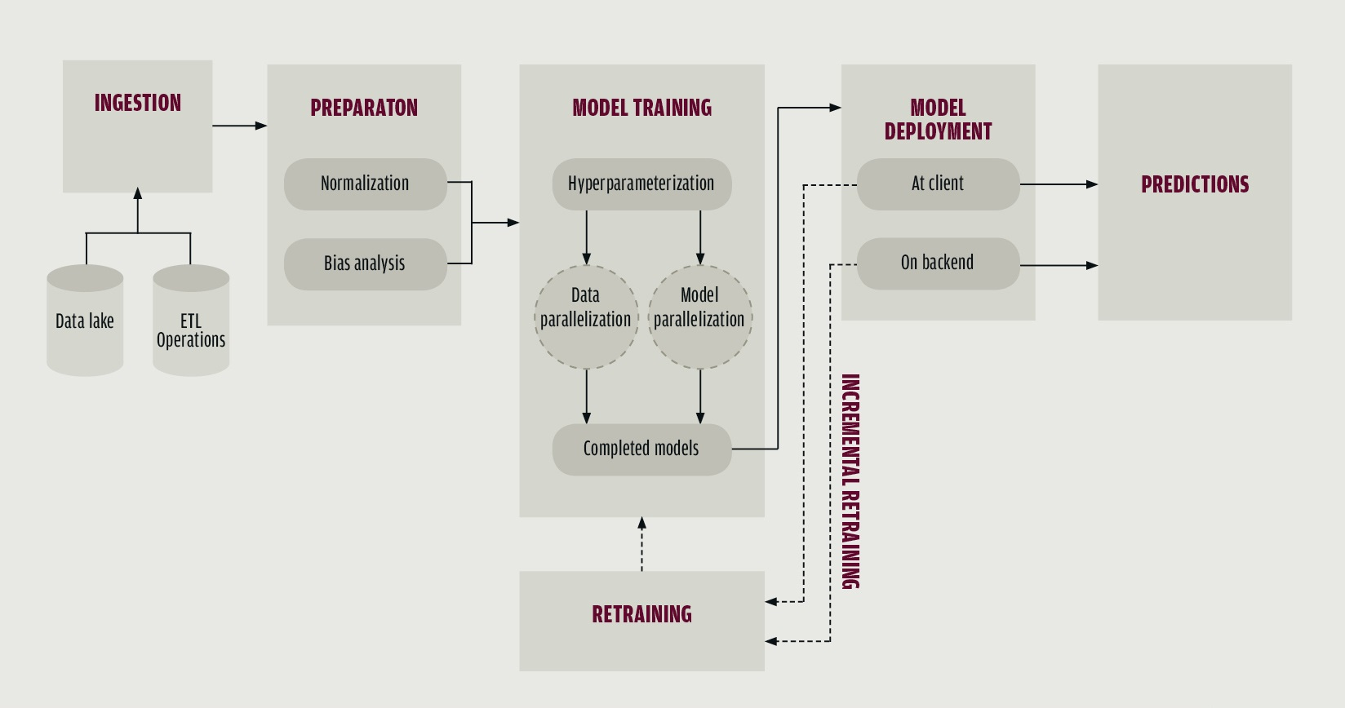
Machine Learning Pipeline

Slide 18
1. Ingestion
Data ingestion is the process of obtaining and importing data. To ingest something is to "take something in or absorb something."
Data can be streamed in real time or ingested in batches.
Extract, Transform, Load (ETL) is the general procedure of copying data from one or more sources into a destination system which represents the data differently from the source(s).
A data lake is a system or repository of data stored in its natural format, usually object blobs or files.

Slide 20
2. Preparation
Data preparation is the act of preparing (or pre-processing) raw data or disparate data sources into refined information assets that can be used effectively for various business purposes, such as analysis.
When you normalize data you eliminate the units of measurement for data, enabling you to more easily compare data from different places.
Using deep analysis of data to help you with decision making is a good idea but it can also backfire if the data is biased. Bias in data analytics can happen either because the humans collecting the data are biased or because the data collected is biased.

Slide 22
3. Model Training
The process of training an ML model involves providing an ML algorithm (that is, the learning algorithm) with training data to learn from. The term ML model refers to the model artifact that is created by the training process.
You can use the ML model to get predictions on new data for which you do not know the target.
Notes:
It involves certain concepts, which we will cover later

Slide 24
4. Model Deployment
The concept of deployment in data science refers to the application of a model for prediction using a new data. Building a model is generally not the end of the project.
Depending on the requirements, the deployment phase can be as simple as generating a report or as complex as implementing a repeatable data science process.
Notes:
2 types, will cover them later

Slide 26
5. Predictions
In the prediction process, trained model is used to infer target values for new data. (business terms)

Slide 28
6. Retraining
Used to maintain machine learning systems.
Ensures that your predictions continue to be accurate, with the help of new training data.
Some of the ways to ensure this : manual retraining, continuous learning.

Slide 29
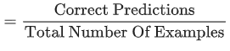
Common terminologies in ML
Accuracy
Bag of words: A representation of the words in a phrase or passage, irrespective of order. For example, bag of words represents the following three phrases identically:
the dog jumps
jumps the dog
dog jumps the
Cross-validation: A mechanism for estimating how well a model will generalize to new data by testing the model against one or more non-overlapping data subsets withheld from the training set.

Slide 30
Common terminologies in ML (cont.)
DataFrame: A popular datatype for representing datasets in pandas. A DataFrame is analogous to a table. Each column of the DataFrame has a name (a header), and each row is identified by a number.
Feature: An input variable used in making predictions.
Feature engineering: The process of determining which features might be useful in training a model, and then converting raw data from log files and other sources into said features. Feature engineering is sometimes called feature extraction.

Slide 31
Common terminologies in ML (cont.)
Feature set: The group of features your machine learning model trains on. For example, postal code, property size, and property condition might comprise a simple feature set for a model that predicts housing prices.
Generalization: Refers to your model's ability to make correct predictions on new, previously unseen data as opposed to the data used to train the model.
Hyperparameter: The "knobs" that you tweak during successive runs of training a model. For example, learning rate is a hyperparameter.

Slide 32
Common terminologies in ML (cont.)
Inference: In machine learning, often refers to the process of making predictions by applying the trained model to unlabeled examples. In statistics, inference refers to the process of fitting the parameters of a distribution conditioned on some observed data.
Label: In supervised learning, the "answer" or "result" portion of an example. Each example in a labeled dataset consists of one or more features and a label. For instance, in a housing dataset, the features might include the number of bedrooms, the number of bathrooms, and the age of the house, while the label might be the house's price.
Loss: A measure of how far a model's predictions are from its label.

Slide 33
Common terminologies in ML (cont.)
One-hot encoding: A sparse vector in which:
One element is set to 1.
All other elements are set to 0.
Overfitting: Creating a model that matches the training data so closely that the model fails to make correct predictions on new data.
Test set: The subset of the dataset that you use to test your model after the model has gone through initial vetting by the validation set.
Training set: The subset of the dataset used to train a model.
Underfitting: Producing a model with poor predictive ability because the model hasn't captured the complexity of the training data.

Slide 34
Main categories of ML algorithms
Machine Learning Algorithms
Supervised
Unsupervised
Reinforcement
Learning

Slide 35
Supervised Algorithms
“The outcome or output for the given input is known before itself”
and the machine must be able to map or assign the given input to the output.
Examples : Regression, Classification

Slide 36
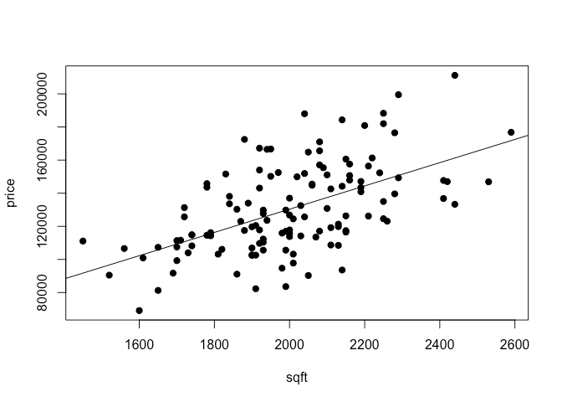
Regression
Predict house price based
on the area of house.

Slide 37
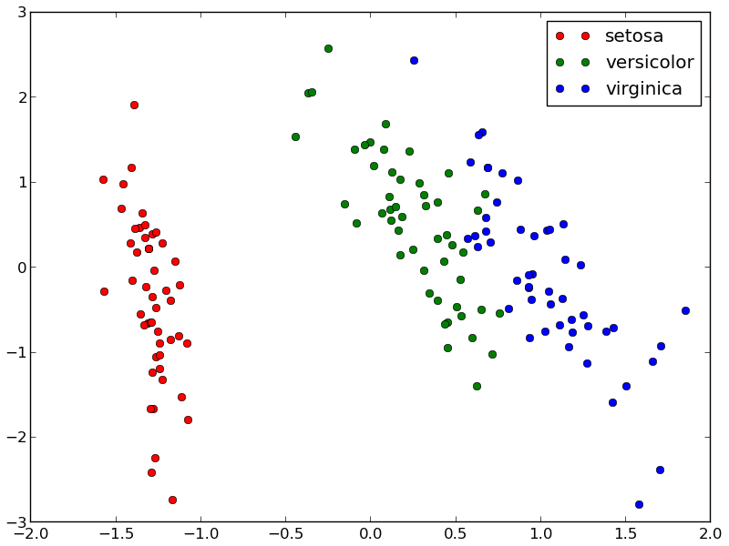
Classification
Predict flower category based
on its dimensions.

Slide 38
Regression vs Classification
Regression Learn a function mapping an input element to a real value. i.e: Predict the temperature of tomorrow given some meteo signals
Classification Learn a function mapping an input element to a class (within a finite set of possible classes).
i.e: Predict the weather of tomorrow: {sunny, cloudy, rainy} given some meteo signals

Slide 39
Unsupervised Algorithms
“The outcome or output for the given inputs is unknown”,
here input data is given and the model is run on it.

Slide 40
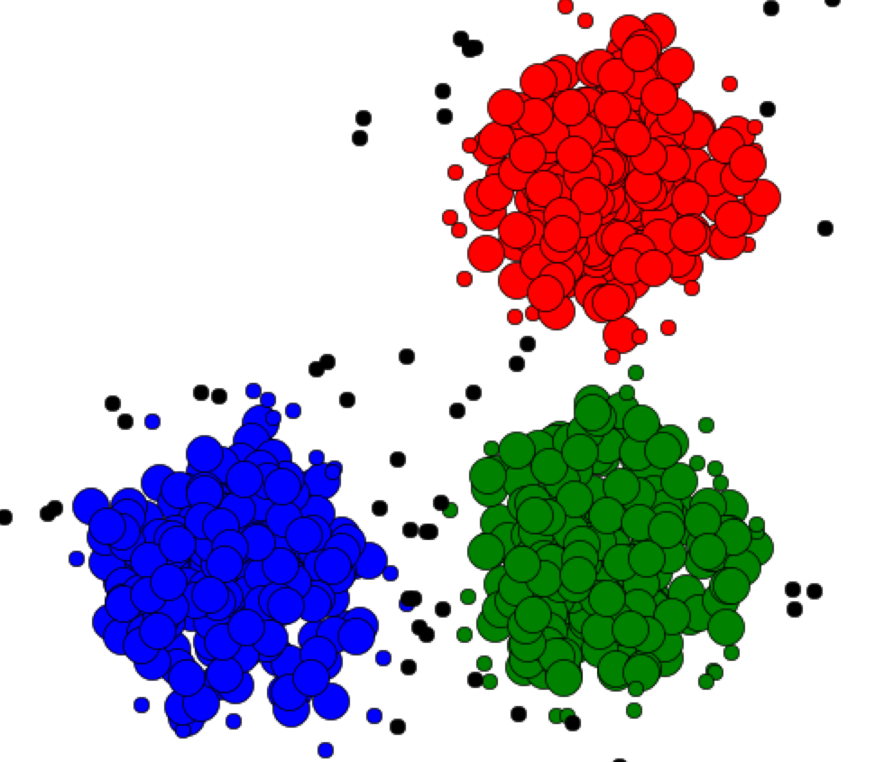
Clustering
A clustering algorithm separate different observed data points in similar groups (clusters). We do not know the labels during training.
Cluster 1
Cluster 3
Cluster 2
Illustration: Rana Forsati

Slide 41
Reinforcement Learning
The machine is exposed to an environment where it gets trained by trial and error method.
The machine learns from past experience and
tries to capture the best possible knowledge to make accurate decisions based on the
feedback received.

Slide 42
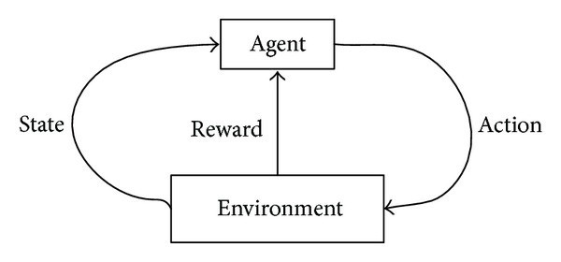
Reinforcement learning
Learn the optimal behavior for an agent in an environment to maximize a given goal.
Examples:
Drive a car on a road and minimize the collision risk
Play video-games
Choose the position of ads on a website to maximize the number of clicks

Slide 43
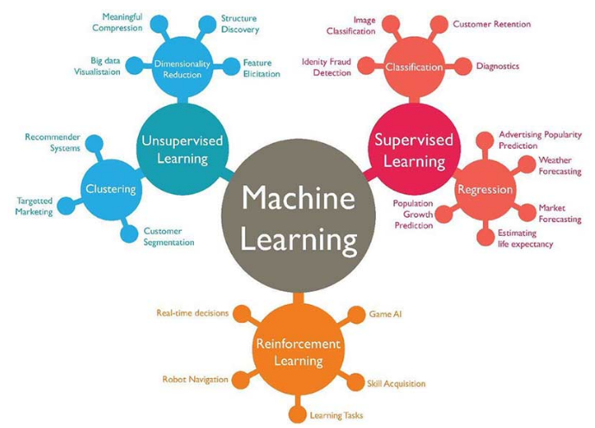
Examples of ML Algorithm applications

Slide 44
Common Machine Learning Algorithms

Slide 45
List of Common Machine Learning Algorithms
ML Algorithm | Algorithm Type
Linear Regression | Supervised - Regression
Logistic Regression | Supervised - Classification
Decision Tree | Supervised - Mostly used for Classification
SVM | Supervised - Classification and Regression
Naive Bayes | Supervised - Classification
kNN | Supervised
K-Means | Unsupervised - Clustering
Random Forest | Supervised
Dimensionality Reduction Algorithms
Gradient Boosting algorithms (appendix)

Slide 46

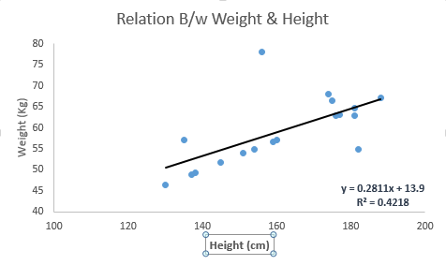
Linear Regression
Linear Regression Coding Time !
It is used to estimate real values (cost of houses, number of calls, total sales etc.) based on continuous variable(s).
Two types:
Simple Linear Regression
Multiple Linear Regression
C:\Users\... > jupyter notebook

Slide 47

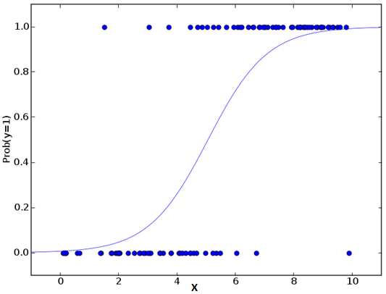
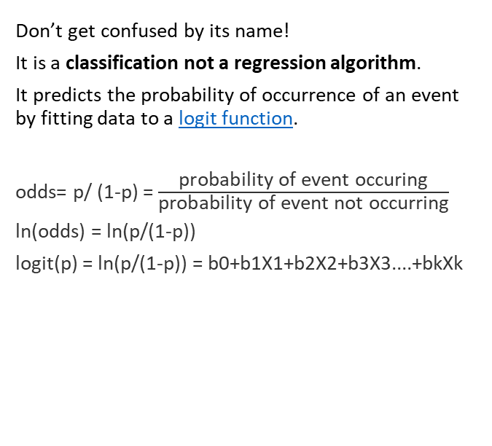
Logistic Regression
Don’t get confused by its name!
It is a classification not a regression algorithm.
It predicts the probability of occurrence of an event by fitting data to a logit function.
odds= p/ (1-p) = $\frac{\text{probability} \text{of} \text{event} \text{occuring}}{\text{probability} \text{of} \text{event} \text{not} \text{occurr}\text{ing}}$
ln(odds) = ln(p/(1-p))
logit(p) = ln(p/(1-p)) = b0+b1X1+b2X2+b3X3....+bkXk
Logistic Regression Coding Time !
C:\Users\... > jupyter notebook

Slide 48

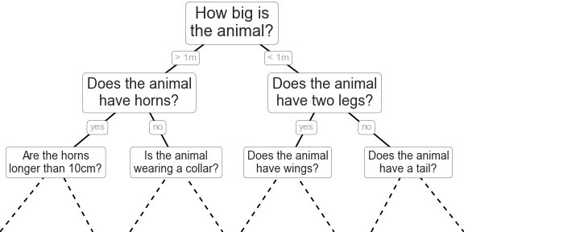
Decision Tree
Decision Tree Coding time !
It is a type of supervised learning algorithm that is mostly used for classification problems.
C:\Users\... > jupyter notebook

Slide 49
SVM
“Support Vector Machine” (SVM) is a supervised machine learning algorithm which can be used for both classification or regression challenges.
In this algorithm, we plot each data item as a point in n-dimensional space (where n is number of features you have) with the value of each feature being the value of a particular coordinate. Then, we perform classification by finding the hyper-plane that differentiate the two classes very well.

Slide 50
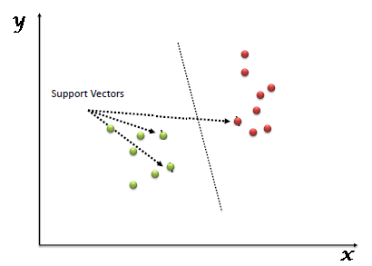
SVM (cont.)
Support Vectors are simply the co-ordinates of individual observation. Support Vector Machine is a frontier which best segregates the two classes (hyper-plane/ line).

Slide 51
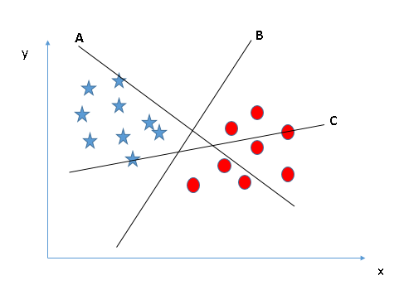
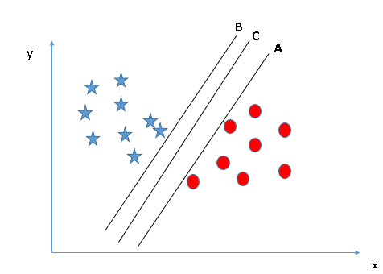
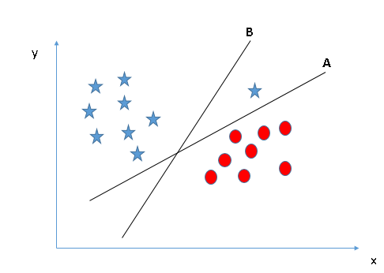
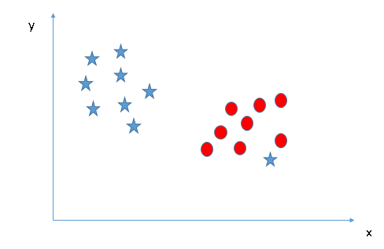
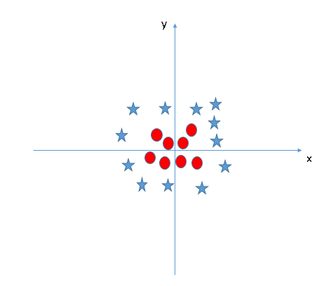
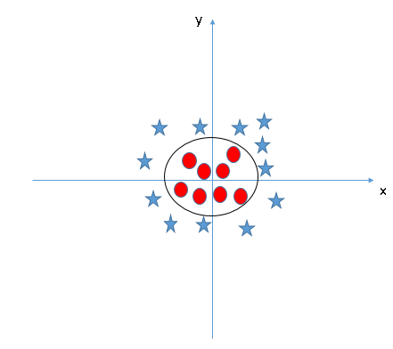
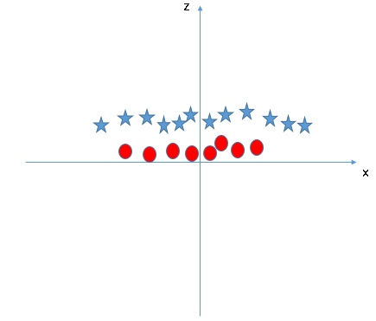
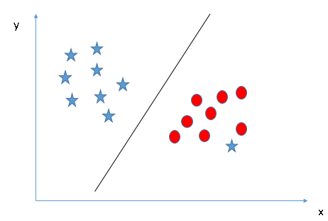
SVM: Identifying the hyper-plane
Case 1
Case 2
Case 3
Case 4
Case 4 (cont)
Case 5
Case 5 (cont)
Case 5 (cont)
Notes:
Right hyper place is B
Right hyper plane is C
Right hyper plane is A
SVM has a feature to ignore outliers and find the hyper-plane that has maximum margin. Hence, we can say, SVM is robust to outliers.
SVM can solve this problem. Easily! It solves this problem by introducing additional feature. Here, we will add a new feature z=x^2+y^2. Now, let’s plot the data points on axis x and z:
In above plot, points to consider are:
All values for z would be positive always because z is the squared sum of both x and y
In the original plot, red circles appear close to the origin of x and y axes, leading to lower value of z and star relatively away from the origin result to higher value of z.
In SVM, it is easy to have a linear hyper-plane between these two classes. But, another burning question which arises is, should we need to add this feature manually to have a hyper-plane. No, SVM has a technique called the kernel trick. These are functions which takes low dimensional input space and transform it to a higher dimensional space i.e. it converts not separable problem to separable problem, these functions are called kernels. It is mostly useful in non-linear separation problem. Simply put, it does some extremely complex data transformations, then find out the process to separate the data based on the labels or outputs you’ve defined.
When we look at the hyper-plane in original input space it looks like a circle:

Slide 52

SVM Coding Time !
C:\Users\... > jupyter notebook

Slide 53

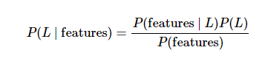
Naive Bayes
Naive Bayes Coding Time !
Naive Bayes models are a group of extremely fast and simple classification algorithms that are often suitable for very high-dimensional datasets.
In Bayesian classification, we're interested in finding the probability of a label given some observed features, which we can write as P(L | features). Bayes's theorem tells us how to express this in terms of quantities we can compute more directly:
C:\Users\... > jupyter notebook

Slide 54
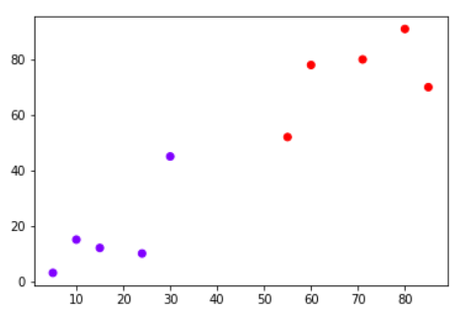
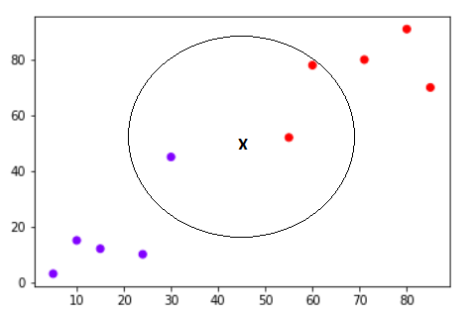
kNN (k- Nearest Neighbors)
The K-nearest neighbors (KNN) algorithm is a type of supervised machine learning algorithms.
KNN is extremely easy to implement in its most basic form, and yet performs quite complex classification tasks. It is a lazy learning algorithm since it doesn't have a specialized training phase. Rather, it uses all of the data for training while classifying a new data point or instance.
KNN is a non-parametric learning algorithm, which means that it doesn't assume anything about the underlying data. This is an extremely useful feature since most of the real world data doesn't really follow any theoretical assumption e.g. linear-separability, uniform distribution, etc.

Slide 55
kNN Coding Time !
C:\Users\... > jupyter notebook

Slide 56

K-Means
Clustering is a type of Unsupervised learning.
This is very often used when you don’t have labeled data.
K-Means Clustering is one of the popular clustering algorithm.
The goal of this algorithm is to find groups(clusters) in the given data.

Slide 57
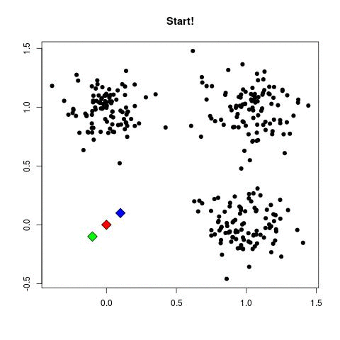
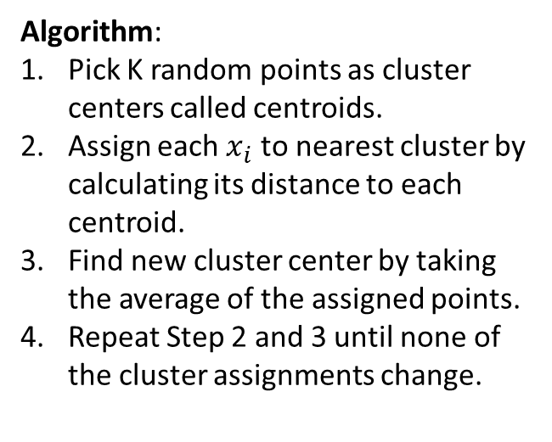
K-Means (cont.)
Algorithm:
Pick K random points as cluster centers called centroids.
Assign each $x_{i}$ to nearest cluster by calculating its distance to each centroid.
Find new cluster center by taking the average of the assigned points.
Repeat Step 2 and 3 until none of the cluster assignments change.

Slide 58

K-Means Coding Time !
C:\Users\... > jupyter notebook

Slide 59
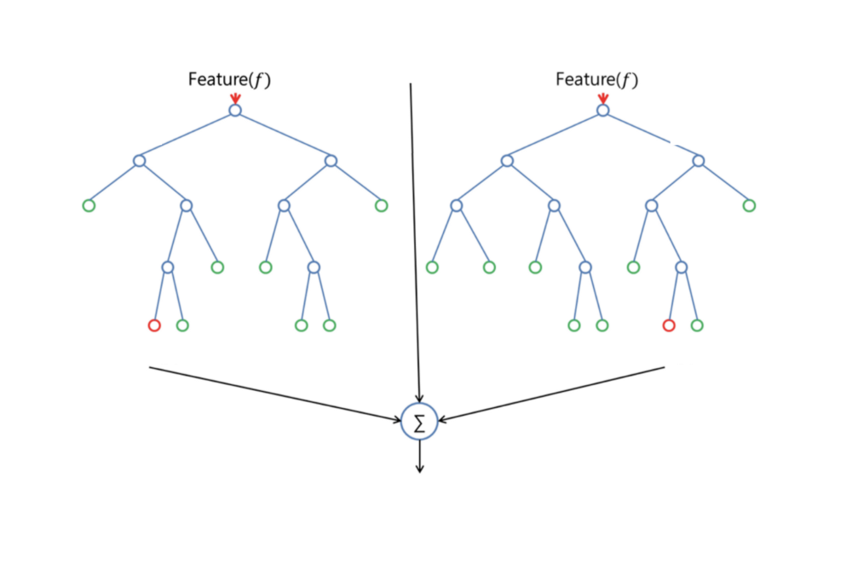
Random Forest
Random Forest is a supervised learning algorithm. Like you can already see from it’s name, it creates a forest and makes it somehow random. The forest it builds, is an ensemble of Decision Trees, most of the time trained with the “bagging” method. The general idea of the bagging method is that a combination of learning models increases the overall result.
To say it in simple words: Random forest builds multiple decision trees and merges them together to get a more accurate and stable prediction.

Slide 60

Random Forest Code
C:\Users\... > jupyter notebook

Slide 61
Dimensionality Reduction Algorithms (Theory)
In machine learning classification problems, there are often too many factors on the basis of which the final classification is done. These factors are basically variables called features.
The higher the number of features, the harder it gets to visualize the training set and then work on it.
Sometimes, most of these features are correlated, and hence redundant. This is where dimensionality reduction algorithms come into play.
Dimensionality reduction is the process of reducing the number of random variables under consideration, by obtaining a set of principal variables. It can be divided into feature selection and feature extraction.

Slide 62
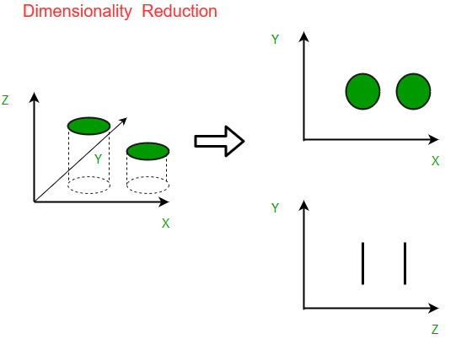
Dimensionality Reduction Algorithms (cont.)
Why is Dimensionality Reduction important in Machine Learning and Predictive Modeling?
The various methods used for dimensionality reduction include:
Principal Component Analysis (PCA)
Linear Discriminant Analysis (LDA)
Generalized Discriminant Analysis (GDA)
Notes:
An intuitive example of dimensionality reduction can be discussed through a simple e-mail classification problem, where we need to classify whether the e-mail is spam or not. This can involve a large number of features, such as whether or not the e-mail has a generic title, the content of the e-mail, whether the e-mail uses a template, etc. However, some of these features may overlap. In another condition, a classification problem that relies on both humidity and rainfall can be collapsed into just one underlying feature, since both of the aforementioned are correlated to a high degree. Hence, we can reduce the number of features in such problems. A 3-D classification problem can be hard to visualize, whereas a 2-D one can be mapped to a simple 2 dimensional space, and a 1-D problem to a simple line. The below figure illustrates this concept, where a 3-D feature space is split into two 1-D feature spaces, and later, if found to be correlated, the number of features can be reduced even further.

Slide 63
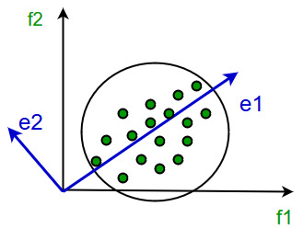
Dimensionality Reduction Algorithms (cont.)
Principal Component Analysis
It works on a condition that while the data in a higher dimensional space is mapped to data in a lower dimension space, the variance of the data in the lower dimensional space should be maximum.
It involves the following steps:
Construct the covariance matrix of the data.
Compute the eigenvectors of this matrix.
Eigenvectors corresponding to the largest eigenvalues are used to reconstruct a large fraction of variance of the original data.

Slide 64

Debugging in ML
When building machine learning models, you’ll often run into situations where a model is not working as well as you would like. Maybe the error rate is too high or the model works fine on the training data, but fails when you apply real world data.

Slide 65

Debugging (cont.) - Typical problems
A machine learning algorithm will generally suffer from one of two problems – high bias or high variance.
High bias is when your algorithm is bad at fitting the data and miss relevant relations between the input features and the predicted output. High bias is also called underfitted – meaning your model is not fitting the data very well and makes poor predictions.
High variance on the other hand is when your algorithm is bad at generalizing. This is normally the case if your algorithm fit the training data perfectly, but when applied to previously unseen data it fails to make good predictions. High variance is also called overfitting.
The image shows examples of a model with high bias (black line) and with high variance (blue line).

Slide 66
Appendix

Slide 67
Gradient Boosting Algorithms
Gradient boosting is a machine learning technique for regression and classification problems, which produces a prediction model in the form of an ensemble of weak prediction models, typically decision trees. It builds the model in a stage-wise fashion like other boosting methods do, and it generalizes them by allowing optimization of an arbitrary differentiable loss function.

Slide 68
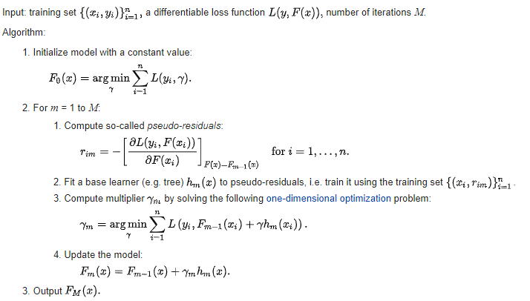
Gradient Boosting Algorithms (cont)

Slide 69
k-nearest neighbors
Classification and regression model
Supervised learning: we have annotated examples
We classify a new example based on the labels of his “nearest neighbors”
k is the number of neighbors taken in consideration

Slide 70
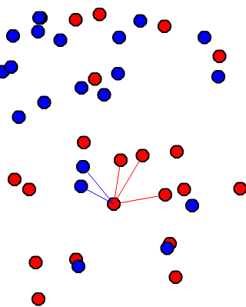
k-nearest neighbors
To classify a point:
We look the k-nearest neighbors (here k=5) and we do a majority vote.
This point has 3 red neighbors and 2 blue neighbors, it will be classified as red.

Slide 71
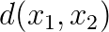
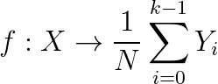
k-nearest neighbors
N data points
Require a distance function between points
Regression (average the value of the k-nearest neighbors)
Classification (majority vote of the k-nearest neighbors)

Slide 72
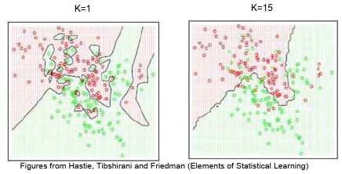
k-nearest neighbors : effect of k
k is the number of neighbors taken in consideration
If k = 1
The accuracy on the training set is 100%
It might not generalize on new data
If k > 1
The accuracy on the training set might not be 100%
It might generalize better on unseen data

Slide 73
k-nearest neighbors : weighted version
In the case of unbalanced repartition between classes we can give weights to the examples.
The weight of a under represented class will be set high.
The weight of a over represented class will be set low.
When we do the majority vote, we take the weight in consideration:
For classification we do a weighted vote.
For regression we do a weighted average.

Slide 74
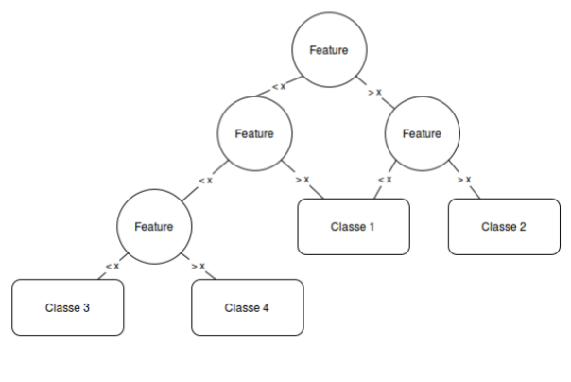
Decision tree

Slide 75
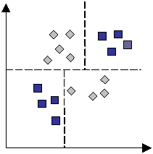
Decision tree
Decision trees partition the feature space by splitting the data
Learning the decision tree consists in finding the order and the split criterion for each node

Slide 76
Decision tree
The decision tree learning is parametrized by the method for choosing the splits and the maximum height
If the maximum height is big enough, all the examples of the training data would be correctly classified: overfitting.

Slide 77
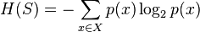
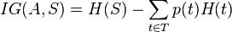
Decision tree : entropy metric
Entropy:
S: The datasets before the split
X: Set of existing classes
p(x): Proportion of elements in class x to the number of elements in S
A: The split criterion
T: The datasets created by the split
At each step we create the node by splitting with the criterion with the highest information gain.

Slide 78
Random forests
When the depth of a decision tree is growing the error on validation data tends to increase a lot: high variance
One way to exploit a lot of data is to train multiple decision trees and average them
Algorithm:
Select N points in the training data and k features (usually sqrt(p))
Learn a new decision tree
Stop when we have enough trees

Slide 79
Clustering with k-means
Clustering algorithm
Require a distance function between points
k is the number of cluster the algorithm will find

Slide 80
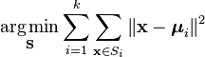
Clustering with k-means
Objective: Divide the dataset in k sets by minimizing the within-cluster sum of squares (sum of distances of each point of the cluster to the center of the cluster)
Where S are the sets we are learning and μ_{i} the mean of the set i.

Slide 81
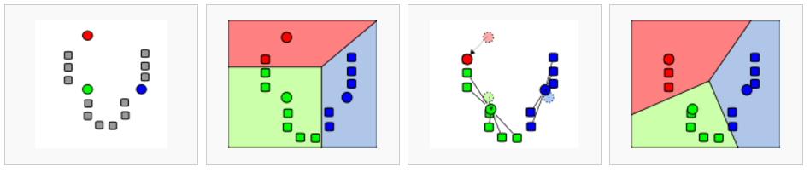
Clustering with k-means
Illustration: Wikipedia, k-means

Slide 82
Gradient descent
Define a model depending on W (the parameters of the model)
Define a loss function that quantify the error the model does on the training data
Compute the gradient of this loss
Adjust W to minimize the loss by following the direction of the computed gradient
Repeat until:
convergence
the model is good enough
your spent all your money

Slide 83
Linear regression

Slide 84
Linear regression : Introduction
In supervised learning, we have examples of lots of input and the desired output value.
This is called the dataset:
A matrix of feature vectors X. Each line is an vector containing an example*.
A vector of target values Y. The kth component is the desired value for the kth example of X.
* : For simplification, the first element x0 = 1.

Slide 85
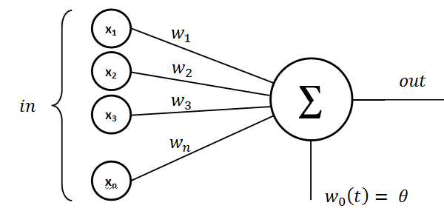
Linear model

Slide 86
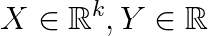
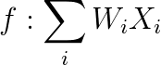
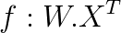
Linear regression
Let say we extracted a real valued vector of features : X
We want to learn a linear relation between this features and an output value : Y
W is called weight vector, it is the parameter of the model. Here we learn the function f by adjusting W.
(also)

Slide 87


Linear regression
With an input of dimension 1, the equation is:
x1 is the input value and w1 is the slope of the linear function
We set x0 = 1 so f(0) = w0
It generalize in higher dimension by multiplying each coordinate of the input by its respective weight.
By adjusting W we can define any hyperplane mapping the input vector to the output value.
The model can be viewed as a line, adjusted by W, mapping the input value to the output value.

Slide 88


Linear regression : error function
We define a function E(W) which quantify the error we observe on the examples. i.e: Euclidean distance between the target and f(X)

Slide 89
Linear regression : error function
We can define the error by using the sum of squared distances between expected targets and the values given by the model:
The training error only depends of W, the dataset is constant during the training.
Problem: Minimize the error by adjusting W (i.e: find the best W such as E is the lowest as possible).

Slide 90


Linear regression : gradient descent
The least squared loss of a linear model is a convex function (“bowl-shaped”)
One simple way to find its minimum is by following the slope of the error.
Illustration: Tom Mitchell, McGraw-Hill

Slide 91

Linear regression : implementation
ipython notebook:

Slide 92

Perceptron : binary classifier
We saw how to learn a linear mapping between input values and targets.
Let’s see a close method for classification: the perceptron.
Learn an hyperplane to separate two class of data-points.
Illustration: Wikipedia, perceptron

Slide 93

Perceptron : binary classifier
Illustration: Wikipedia, perceptron

Slide 94

Perceptron : binary classifier
We learn the parameters W of the function f:
Where t is a transfer function Example: The step function
t(x) = 1 if x > 0
t(x) = -1 otherwise
If the data point is above the hyperplane then it is a member of the class, otherwise it is not.

Slide 95


Perceptron : loss function
We can define the error of the perceptron by the number of elements it correctly classify… But this is a hard problem to optimize.
We use instead a loss function that we will minimize for each example.
One commonly used is:
The error function to minimize (by adjusting W) is:
Notes:
Connect with hinge loss

Slide 96


Slide 97
Principal component analysis
Motivation: Find a linear projection of the features of the dataset to reduce the dimensionality or attenuate the noise.
Method:
Find new orthogonal components by maximizing the variance over each component
It is also the set of orthogonal components which minimize the projection distance

Slide 98

Principal component analysis
Linear regression
PCA
Illustration : Stack Exchange

Slide 99

Principal component analysis

Slide 100


Principal component analysis : covariance matrix
X and Y are two columns of the training set, each containing the value of one feature for all the examples.
Covariance matrix:

Slide 101
Principal component analysis : algorithm
Normalize the dataset
Compute the covariance matrix
Compute the eigenvectors and eigenvalues of the covariance matrix
Sort the eigenvectors by eigenvalues
Build a matrix B with the k first eigenvectors (one per row)
Project the dataset with p(x) = BX

Slide 102
Support vector machine
And the kernel trick

Slide 103

Support vector machine
Objective: Find the hyperplane with the biggest margin separating two classes.
Illustration: Wikipedia, SVM

Slide 104

Support vector machine : nonlinear case

Slide 105

Kernel trick

Slide 106
Kernel trick
Some algorithms only require the dot product between 2 vectors
Instead of computing by:
projecting in a higher dimensional space
compute the dot product
We can use the kernel trick:
There exists some functions (Mercer’s condition) which are cheap to compute and can be expressed as a dot product in a higher dimensional space.

Slide 107

Kernel trick
Polynomial kernel
RBF kernel

Slide 108
Bias and variance
When applying a ML algorithm, we do some assumptions to learn the model:
k-nn: neighborhood influence
linear model: linear mapping between input and output, loss function
perceptron: we can separate the data linearly, loss function
SVM: kernel type, hyperparameters
Those assumptions will influence the bias and the variance of the model

Slide 109

Bias and variance
Illustration: Andrew Ng

Slide 110

Bias variance
Big error (underfitting):
High bias
Low variance
Good tradeoff
Big error rate (overfitting):
Low bias
High variance
High bias
Low bias

Slide 111
Neural networks
(Multilayer perceptron)

Slide 112

Neural networks
From the perceptron seen previously we can build a multilayer perceptron
By chaining multiple non-linear function we allow the model to learn more complex relationships between input and output.

Slide 113

Neural network : forward pass
The forward pass consists in evaluating the output of the neural network.
It compute the output from the first layer to the last layer.

Slide 114

Neural networks : backward pass
We can compute easily the gradient of the error with respect to the weight of the last layer
The gradient of the error with respect to the weight of the others layers are computable by applying the chain rule :

Slide 115
Neural network : matrix optimization
It is possible to see the neural network as multiple matrix operations by considering each layer as a matrix of weights.
It simplify the algorithm and it’s way faster at training time!
Hardware optimization
Can be executed on GPU

Slide 116


Slide 117
Deep learning
A gentle introduction

Slide 118


Autoencoders
Learn the identity function (unsupervised learning)
The data is compressed then reconstructed
The hidden layer is called bottleneck
It contains an “embedding” of the input
Illustration: Stack exchange

Slide 119

Shallow VS deep networks

Slide 120
Deep learning : convolutional neural network
High resolution images contains O(millions) of pixels
A neural network which can handle that kind of images would also have O(millions) of weight
Solution: Repeat the same part of the network over the whole image area

Slide 121

Deep learning : convolutional filter
Example: Edge detection

Slide 122

Deep learning : convolutional neural network
Illustration: Theano documentation
This kind of architecture will learn filters and build an internal representation of the input data using many stacked layers and finally use this representation on a classification task.

Slide 123


Learn high level features of a cat
Training: 16.000 CPU during 3 days
Learned high levels features of cats, human faces by watching Youtube videos
Totally unsupervised : unlabeled data
“Best neuron” activation heat map
Building High-level Features Using Large Scale Unsupervised Learning
Quoc Le, Marc'Aurelio Ranzato, Rajat Monga, Matthieu Devin, Kai Chen, Greg Corrado, Jeff Dean, Andrew Ng

Slide 124


Deep learning : convolutional neural networks
ImageNet Classification with Deep Convolutional Neural Networks Alex Krizhevsky, Ilya Sutskever, Geoffrey E. Hinton
The model learns some edge detection filter. We find a similar process in the cells of the primary visual cortex of the human brain
Edge detectors filters :

Slide 125

Word embedding models

Slide 126

Word2vec : distance metric
Nearest neighbors of “France” :
The model learn embeddings (a float vector) to represent words such as two words close in the semantic space are close in the embedding space
Cosine distance (~ L2 distance when vectors are normalized)
word2vec - https://code.google.com/p/word2vec/

Slide 127

Word2vec : PCA data visualisation

Slide 128

ImageNet challenge
Visit : http://www.image-net.org
Detection and classification of images over 1000 different classes
Deep learning leads to a breakthrough in prediction quality
GoogleNet is the architecture who won the challenge in 2014

Slide 129


ImageNet : Humans vs Machine
ImageNet Large Scale Visual Recognition Challenge
arXiv:1409.0575 - Olga Russakovsky, Jia Deng et al.

Slide 130

Image description : conv-nn + LSTM
Show and Tell: A Neural Image Caption Generator
arXiv:1411.4555 - Oriol Vinyals, Alexander Toshev, Samy Bengio, Dumitru Erhan

Slide 131

Image description : conv-nn + LSTM
Show and Tell: A Neural Image Caption Generator
arXiv:1411.4555 - Oriol Vinyals, Alexander Toshev, Samy Bengio, Dumitru Erhan

